Slide 1


Parallel In-Memory Evaluation of Spatial Joins Poster Id: 28
Dimitrios Tsitsigkos^{1,3} Panagiotis Bouros²
Nikos Mamoulis³ Manolis Terrovitis¹
¹ Athena RC, Greece
² Johannes Gutenberg University Mainz, Germany
³ University of Ioannina, Greece

Slide 2
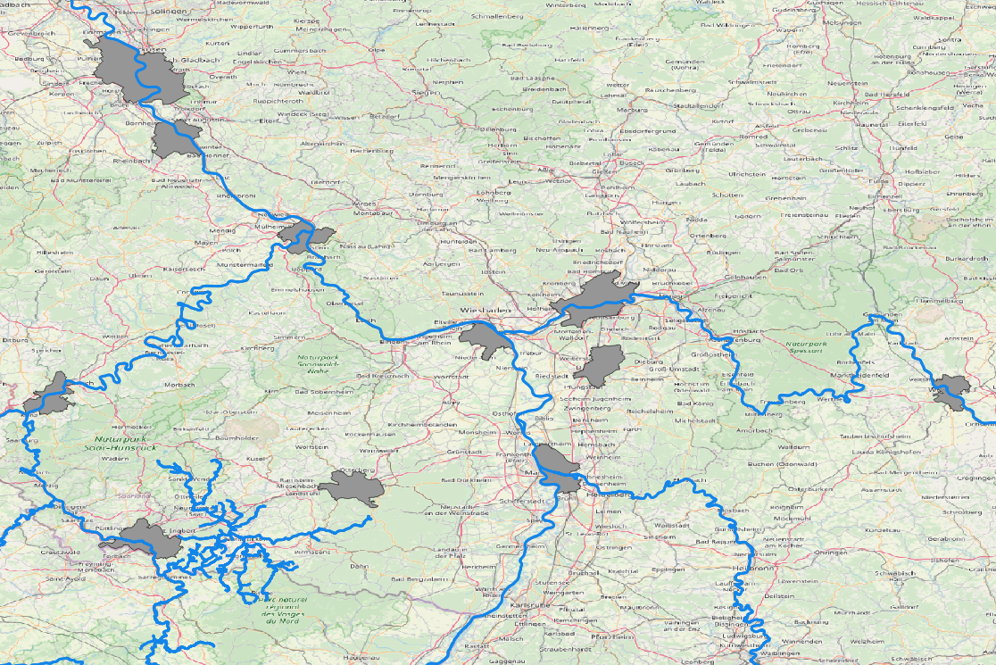
Spatial Joins
Fundamental data operation
GIS, data analysis taks, scientific applications etc.
Find pairs of rivers and cities that intersect

Slide 3
Partition-based Evaluation
PBSM [Patel and DeWitt 1996]
Multi-assignment, single-join (MASJ)
One independent join task per partition
Suitable for dynamic data, no preprocessing
Simple, easy to implement
Adopted by all distributed spatial DMS
Challenges
In-memory evaluation
Type and number of partitions
Vs
Handing duplicates
Selecting sweeping axis
Parallel processing on multi-core CPUs

